Slide 1
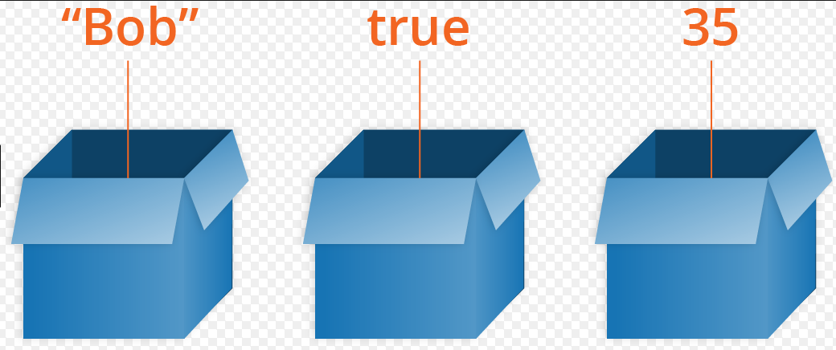
Variables

Slide 2
What is a variable?
Variables are used to store information to be referenced and manipulated in a computer program.
They also provide a way of labeling data with a descriptive name, so our programs can be understood more clearly by the reader and ourselves.
It is helpful to think of variables as containers that hold information.
Their sole purpose is to label and store data in memory. This data can then be used throughout your program.

Slide 3
Assigning Variables – Some Best Practices
Naming variables is known as one of the most difficult tasks in computer programming
Try your best to make sure that the name you assign your variable is descriptive and understandable to another reader

